Slide 1

ICE 3161
COMMUNICATION ENGINEERING
Dr. Asif Zaman
Professor, CSE, RU

Slide 2
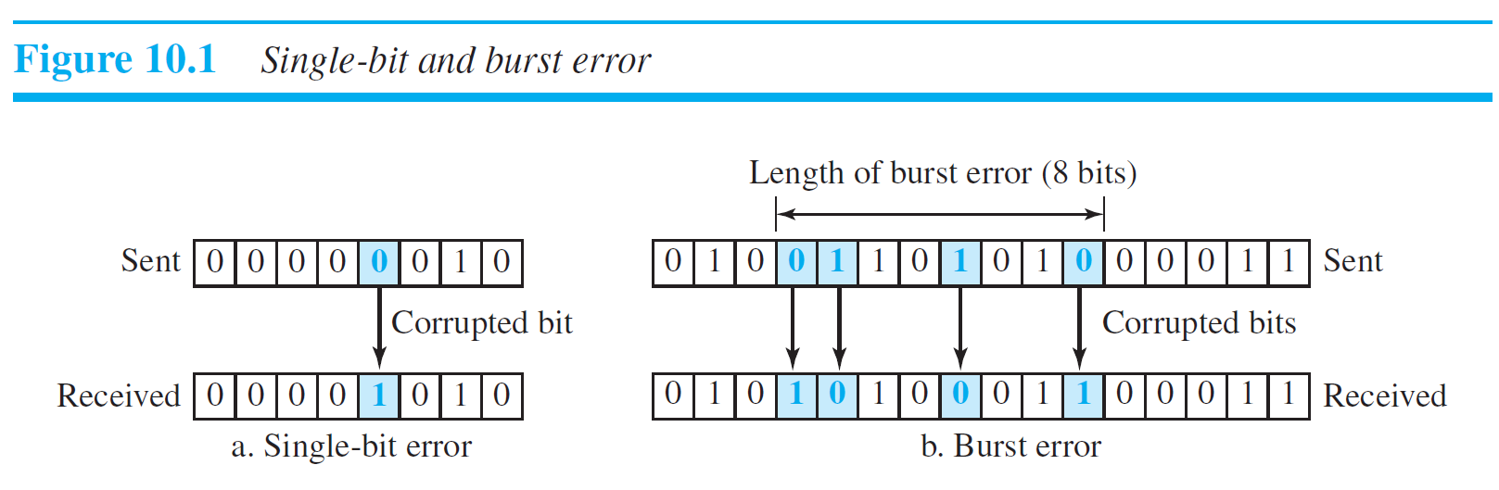
Types of Errors
The central concept in detecting or correcting errors is redundancy.

Slide 3
Detection vs Correction
The correction of errors is more difficult than the detection.
In error detection, we are only looking to see if any error has occurred.
The answer is a simple yes or no.
In error correction, we need to know the exact number of bits that are corrupted and, more importantly, their location in the message.
If we need to correct a single error in an 8-bit data unit, we need to consider eight possible error locations;
if we need to correct two errors in a data unit of the same size, we need to consider 28 possibilities.
.. imagine the receiver’s difficulty in finding 10 errors in a data unit of 1000 bits.

Slide 4

8 | 7 | 6 | 5 | 4 | 3 | 2 | 1
8 | 7 | 6 | 5 | 4 | 3 | 2 | 1
8 | 7 | 6 | 5 | 4 | 3 | 2 | 1
8 | 7 | 6 | 5 | 4 | 3 | 2 | 1
8 | 7 | 6 | 5 | 4 | 3 | 2 | 1
8 | 7 | 6 | 5 | 4 | 3 | 2 | 1
8 | 7 | 6 | 5 | 4 | 3 | 2 | 1
8 | 7 | 6 | 5 | 4 | 3 | 2 | 1
8 | 7 | 6 | 5 | 4 | 3 | 2 | 1
8 | 7 | 6 | 5 | 4 | 3 | 2 | 1
28

Slide 5
Coding
Redundancy is achieved through various coding schemes.
We can divide coding schemes into two broad categories:
Block coding
Convolution coding. (convolution coding is more complex and beyond the scope of this book)

Slide 6
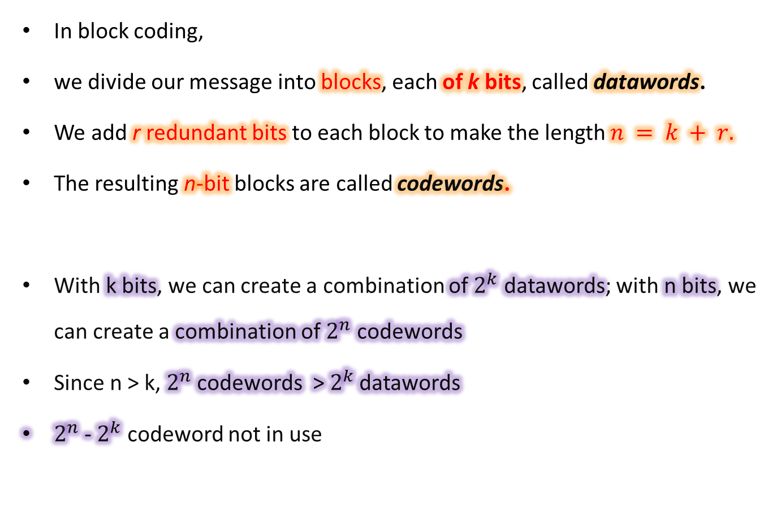
Block Coding
In block coding,
we divide our message into blocks, each of k bits, called datawords.
We add r redundant bits to each block to make the length $n = k + r.$
The resulting n-bit blocks are called codewords.
With k bits, we can create a combination of $2^{k}$ datawords; with n bits, we can create a combination of $2^{n}$ codewords
Since n > k, $2^{n}$ codewords >${ 2}^{k}$ datawords
$2^{n}$ -${ 2}^{k}$ codeword not in use

Slide 7
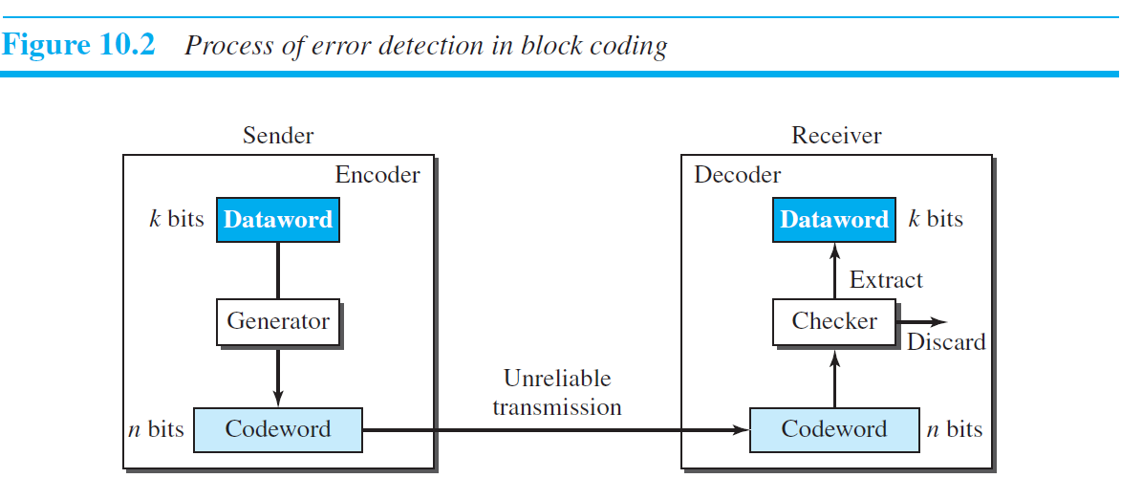
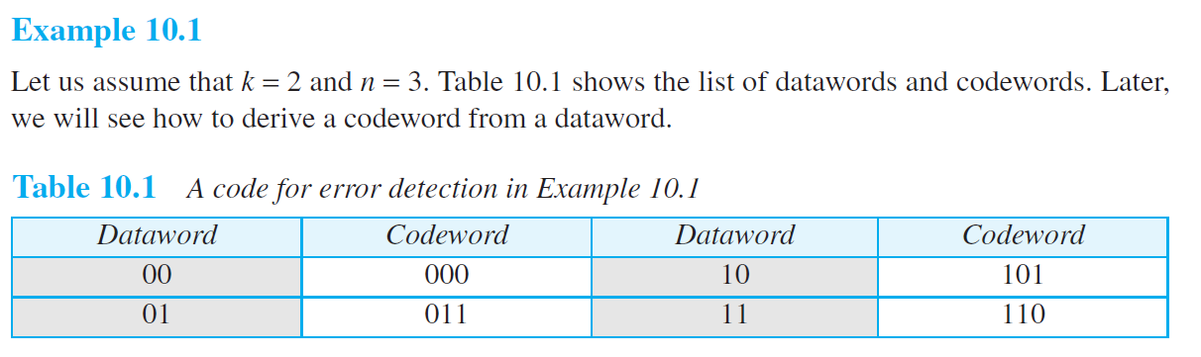

Slide 8
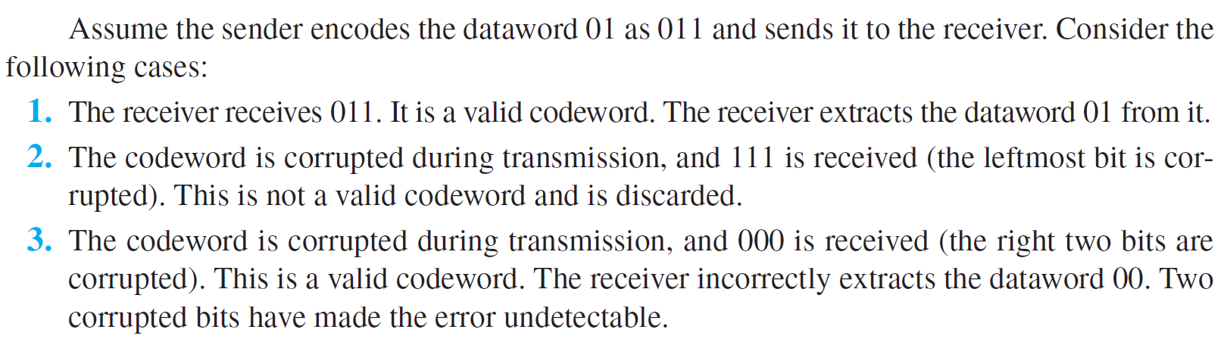
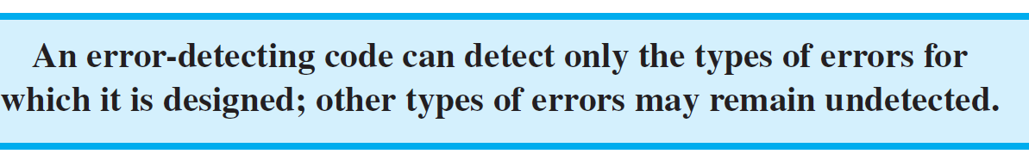

Slide 9
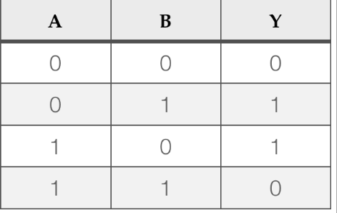
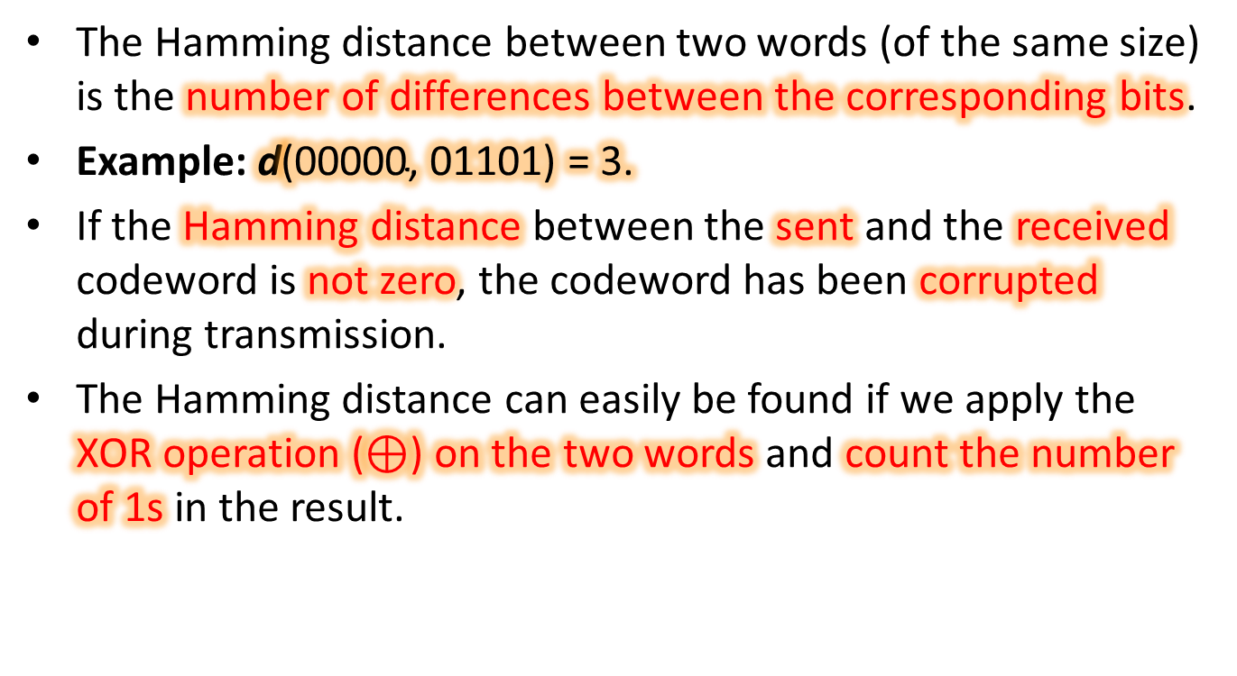
Hamming Distance
The Hamming distance between two words (of the same size) is the number of differences between the corresponding bits.
Example: $\text{d}\text{(00000, 01101) = 3.}$
If the Hamming distance between the sent and the received codeword is not zero, the codeword has been corrupted during transmission.
The Hamming distance can easily be found if we apply the XOR operation (⊕) on the two words and count the number of 1s in the result.

Slide 10
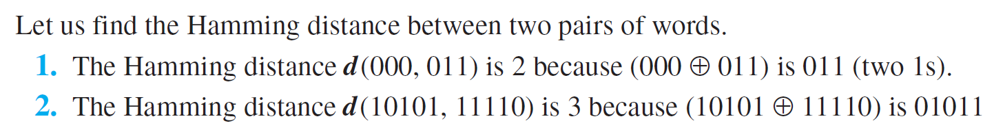

Minimum Hamming Distance for Error Detection:
In a set of codewords, the minimum Hamming distance is the smallest Hamming distance between all possible pairs of codewords.

Slide 11
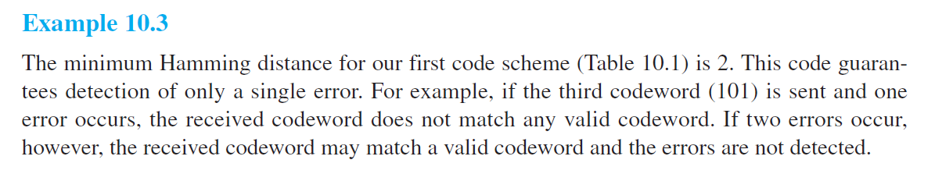
Linear Block Codes:
Almost all block codes used today belong to a subset of block codes called linear block codes.
A linear block code is a code in which the exclusive OR (addition modulo-2) of two valid codewords creates another valid codeword

Slide 12
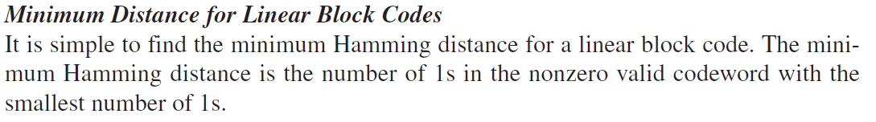
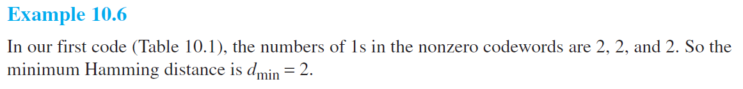

Slide 13
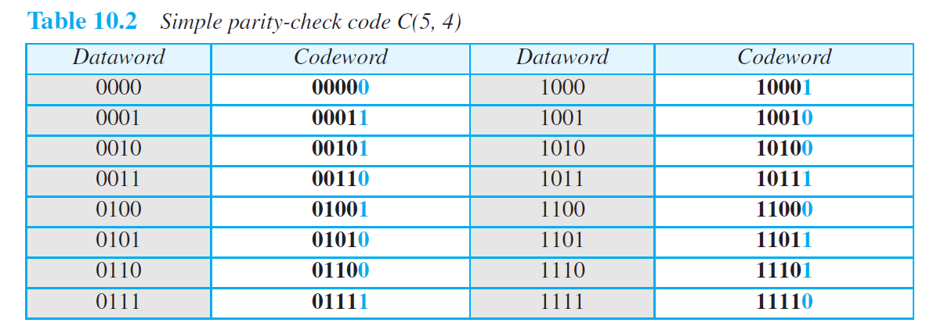

Parity-Check Code

Slide 14
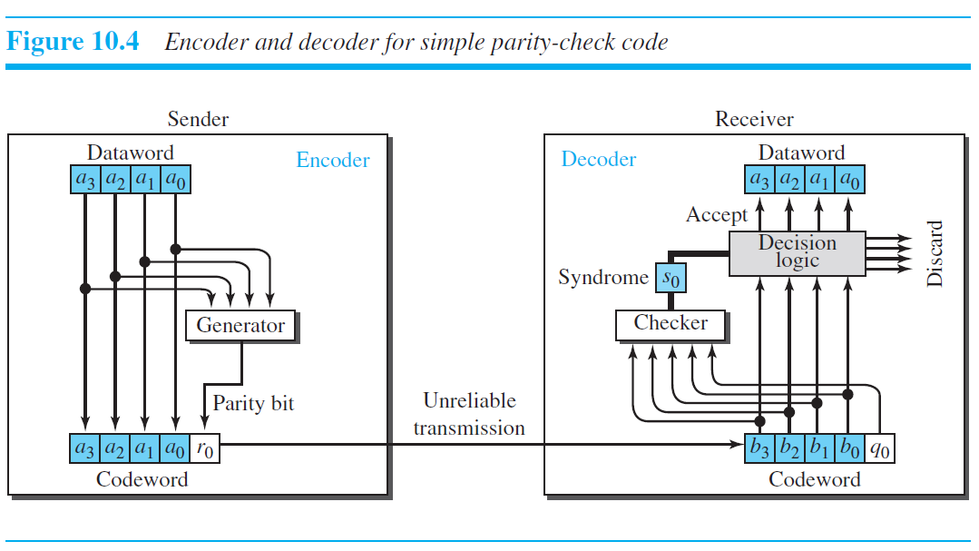





$$1011$$
$$10111$$
$$1 + 0+ 1+1 =3 \% 2=1$$
$$1 + 0+ 1+1+1 =4 \% 2=0$$

Slide 15
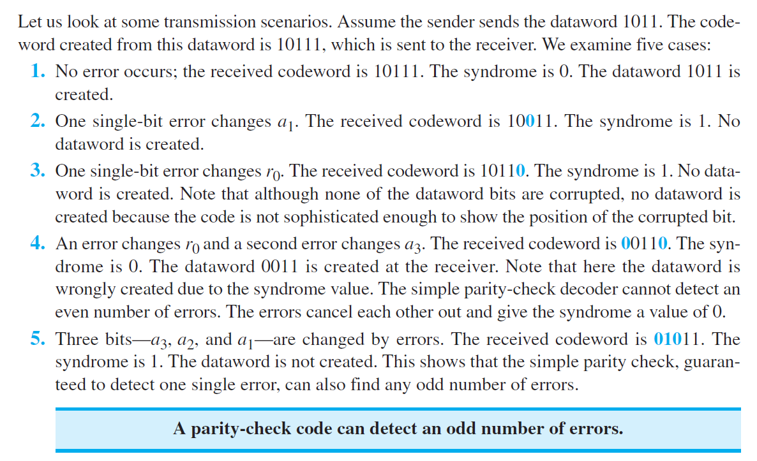

Slide 16
Cyclic Codes
Cyclic codes are special linear block codes with one extra property.
In a cyclic code, if a codeword is cyclically shifted (rotated), the result is another codeword.
For example,if 1011000 is a codeword and we cyclically left-shift, then 0110001 is also a codeword

Slide 17
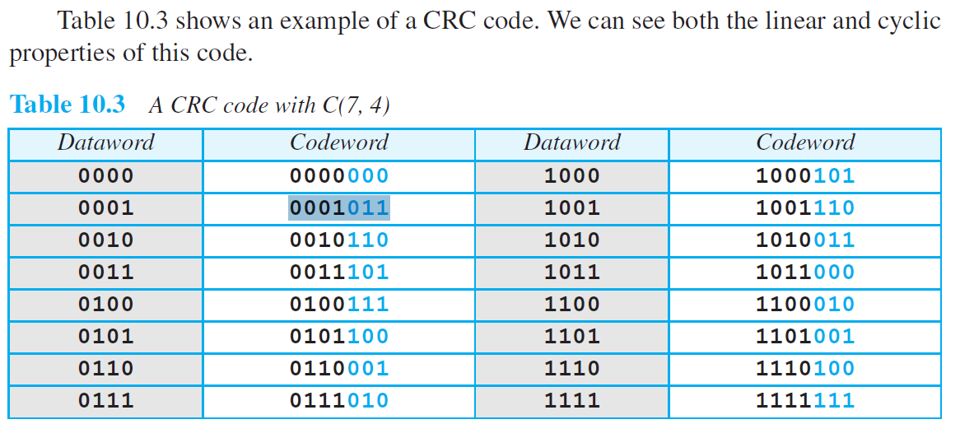
Cyclic Redundancy Check (CRC)
0001011
0010110
0011101

Slide 18
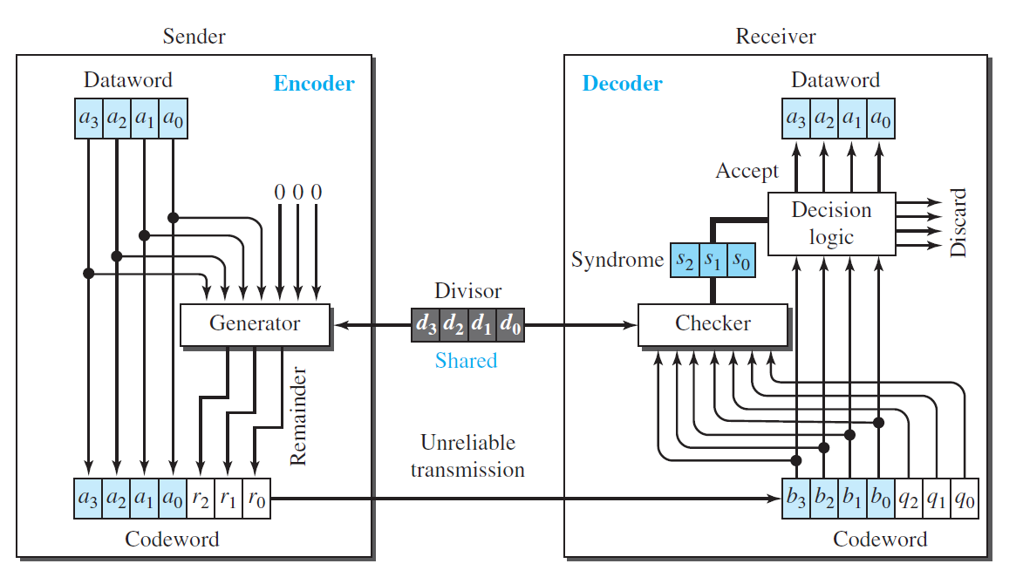

Slide 19
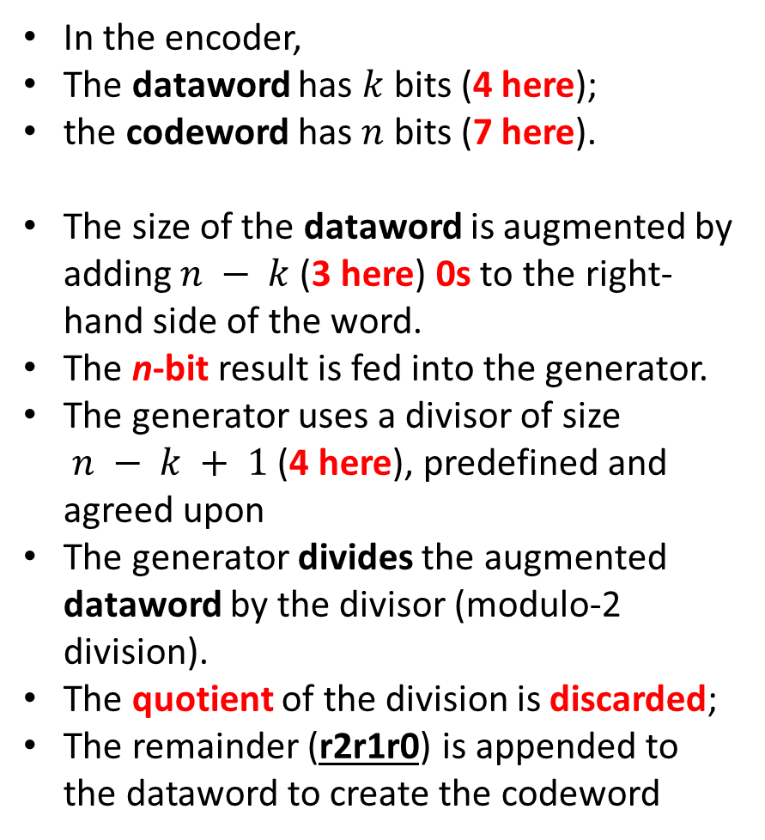
In the encoder,
The dataword has $k$ bits (4 here);
the codeword has $n$ bits (7 here).
The size of the dataword is augmented by adding $n − k$(3 here) 0s to the right-hand side of the word.
The n-bit result is fed into the generator.
The generator uses a divisor of size $n − k + 1$(4 here), predefined and agreed upon
The generator divides the augmented dataword by the divisor (modulo-2 division).
The quotient of the division is discarded;
The remainder (r2r1r0) is appended to the dataword to create the codeword

Slide 20
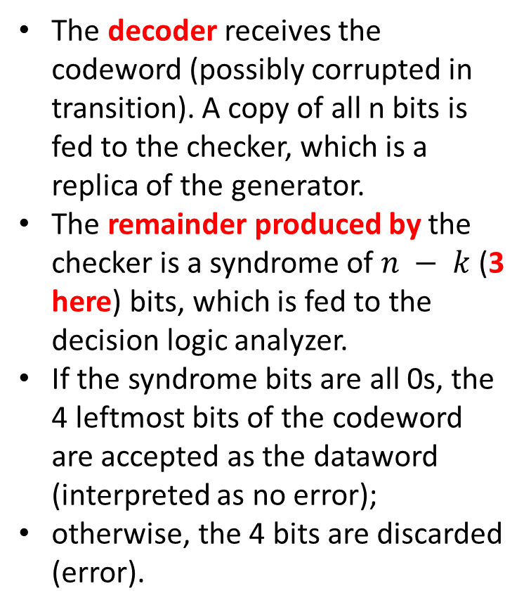
The decoder receives the codeword (possibly corrupted in transition). A copy of all n bits is fed to the checker, which is a replica of the generator.
The remainder produced by the checker is a syndrome of $n − k$(3 here) bits, which is fed to the decision logic analyzer.
If the syndrome bits are all 0s, the 4 leftmost bits of the codeword are accepted as the dataword (interpreted as no error);
otherwise, the 4 bits are discarded (error).

Slide 21
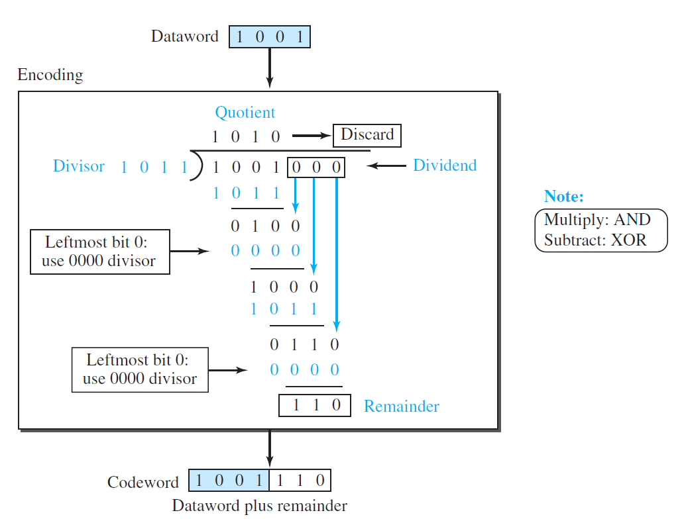

Slide 22
